Slide 1

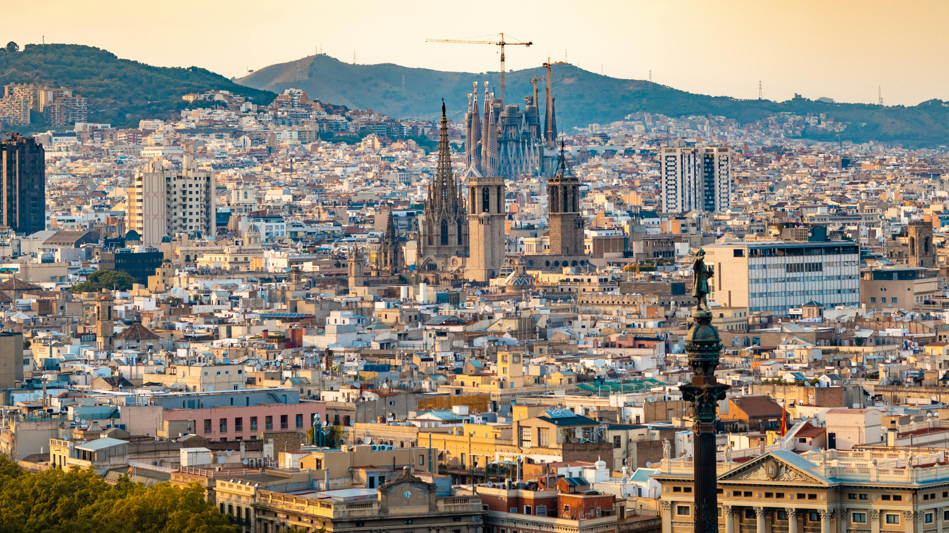
Barcelona
Vasukumar, Sabit, Harpreet, and Chaitanya

Slide 2
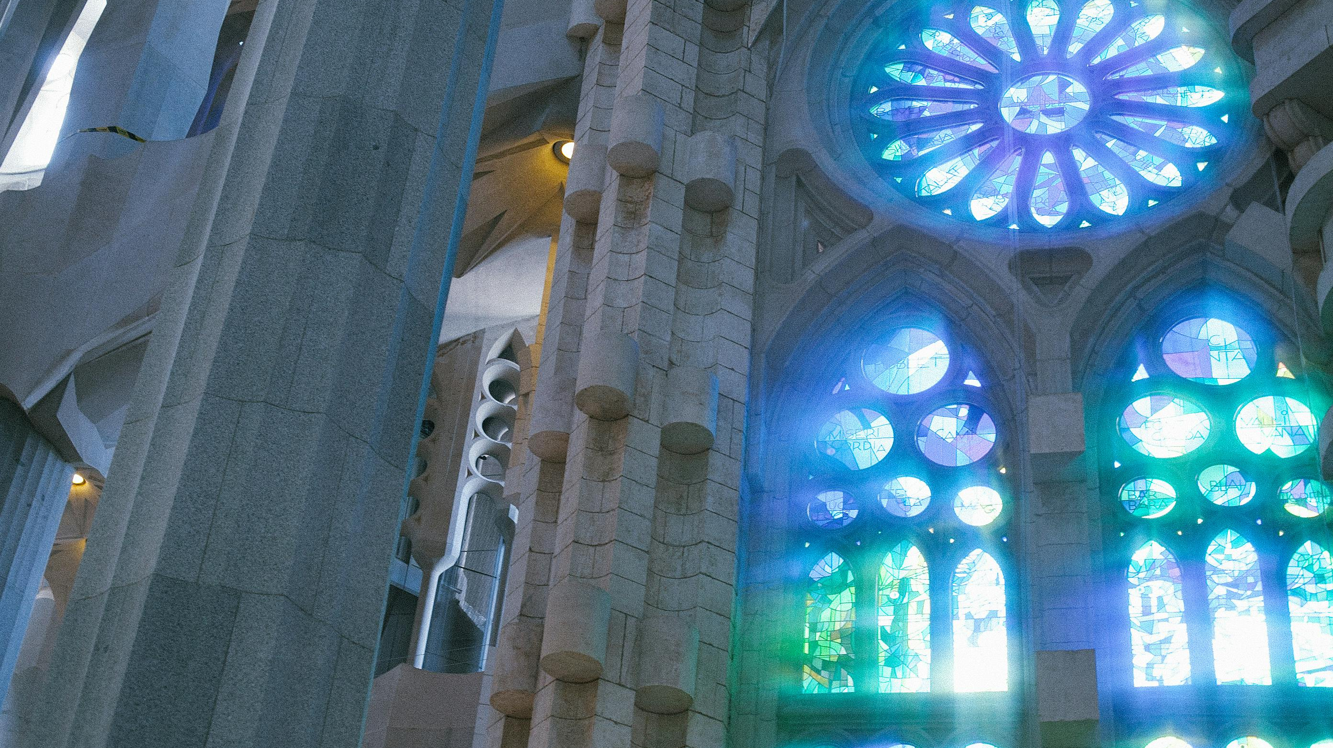
Contents
Introduction
Attractions
Foods
Festivals and events
Activities
Summary
References

Slide 3
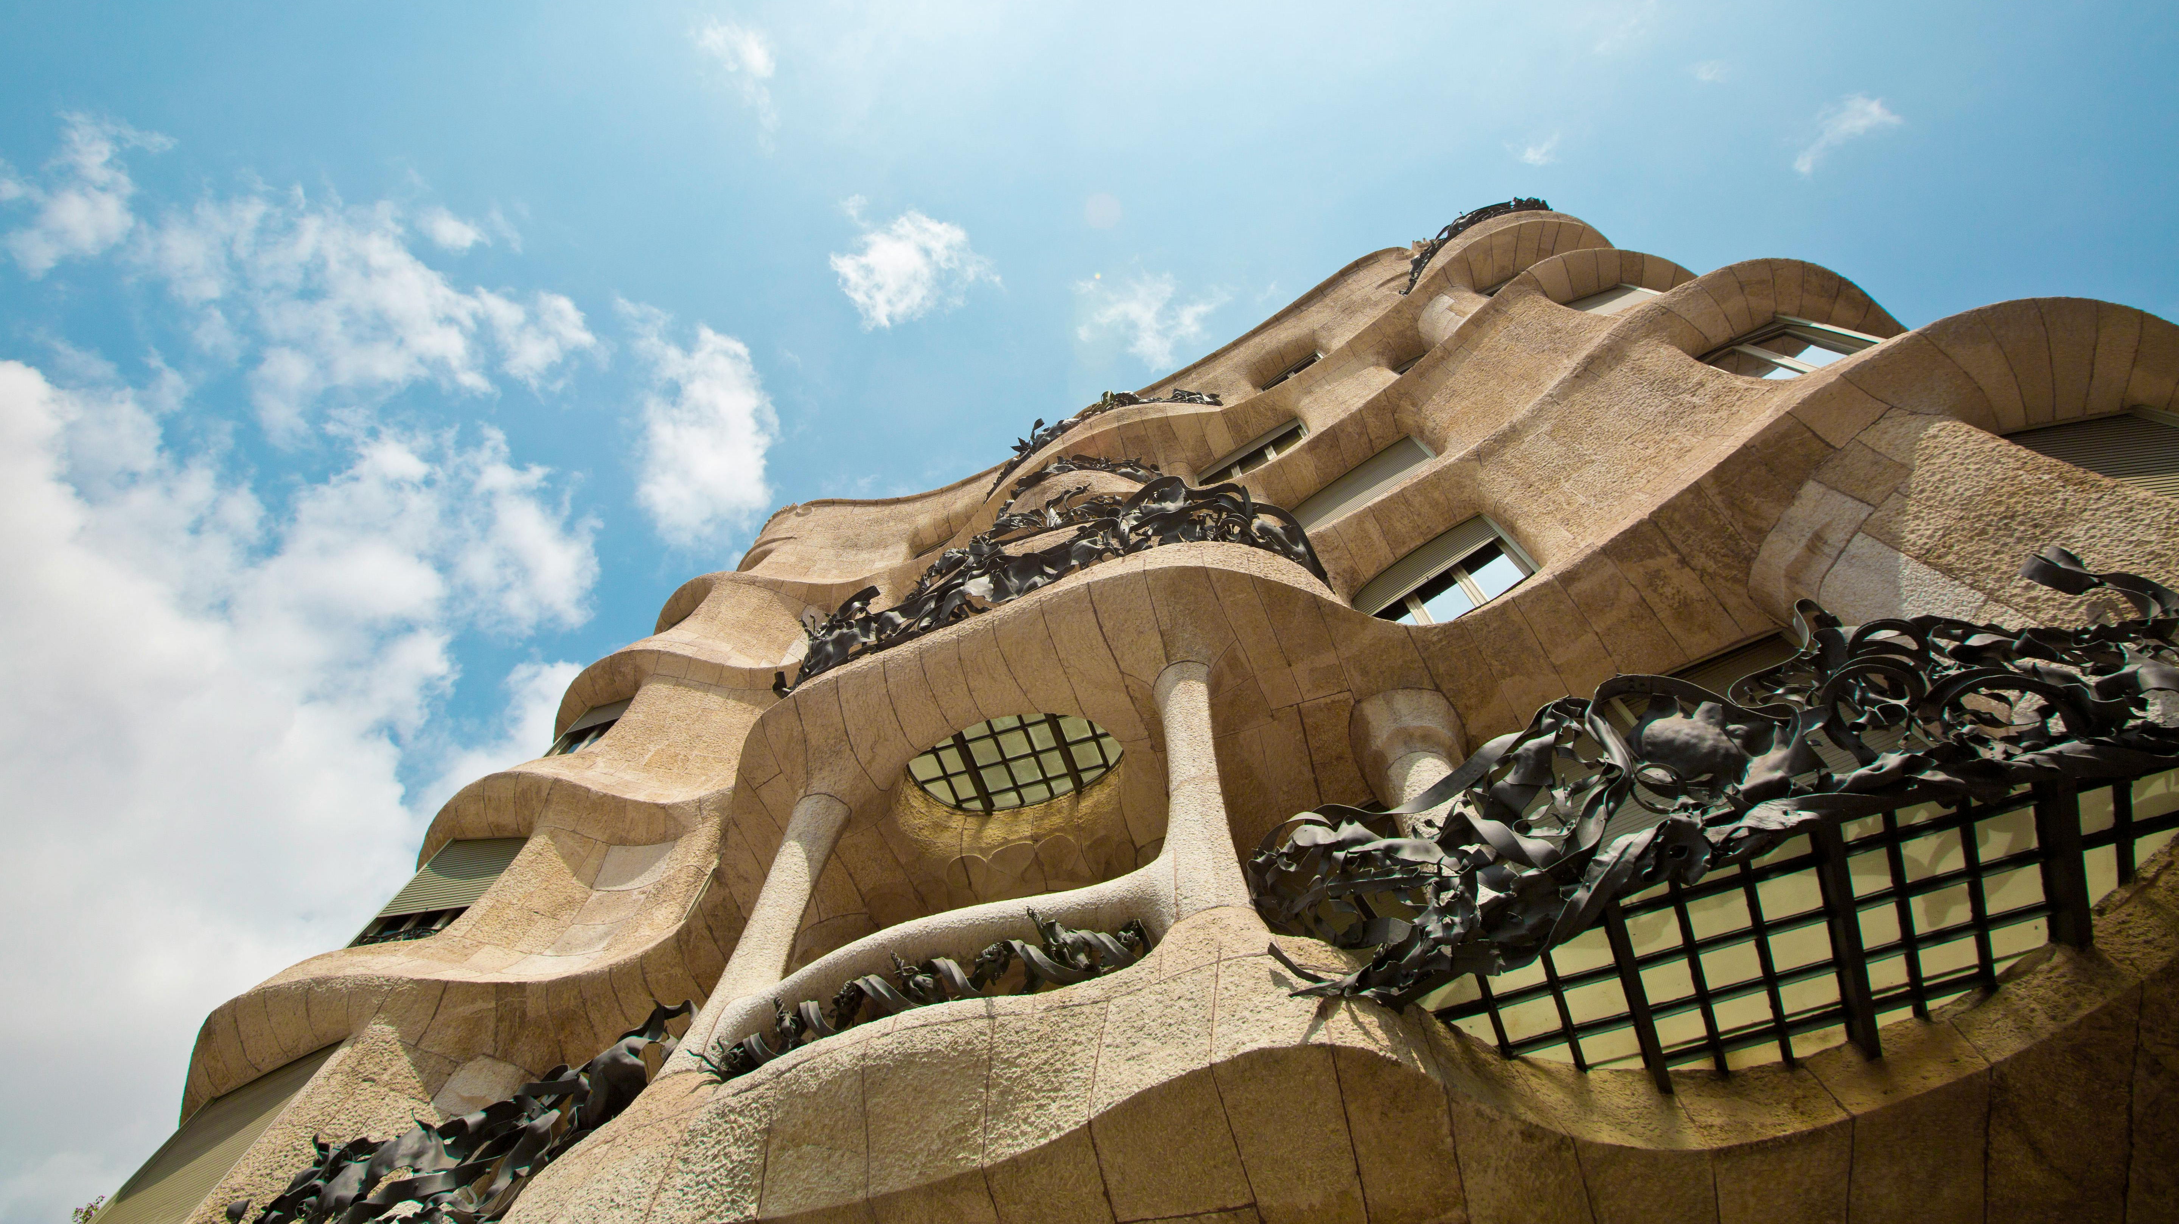
Introduction
Who are we?
Vasukumar Patel – Gujarat, India.
Sabit Naim – Dhaka, Bangladesh.
Harpreet Singh – Punjab, India.
Chaitanya Patel – Gujarat, India.

Slide 4
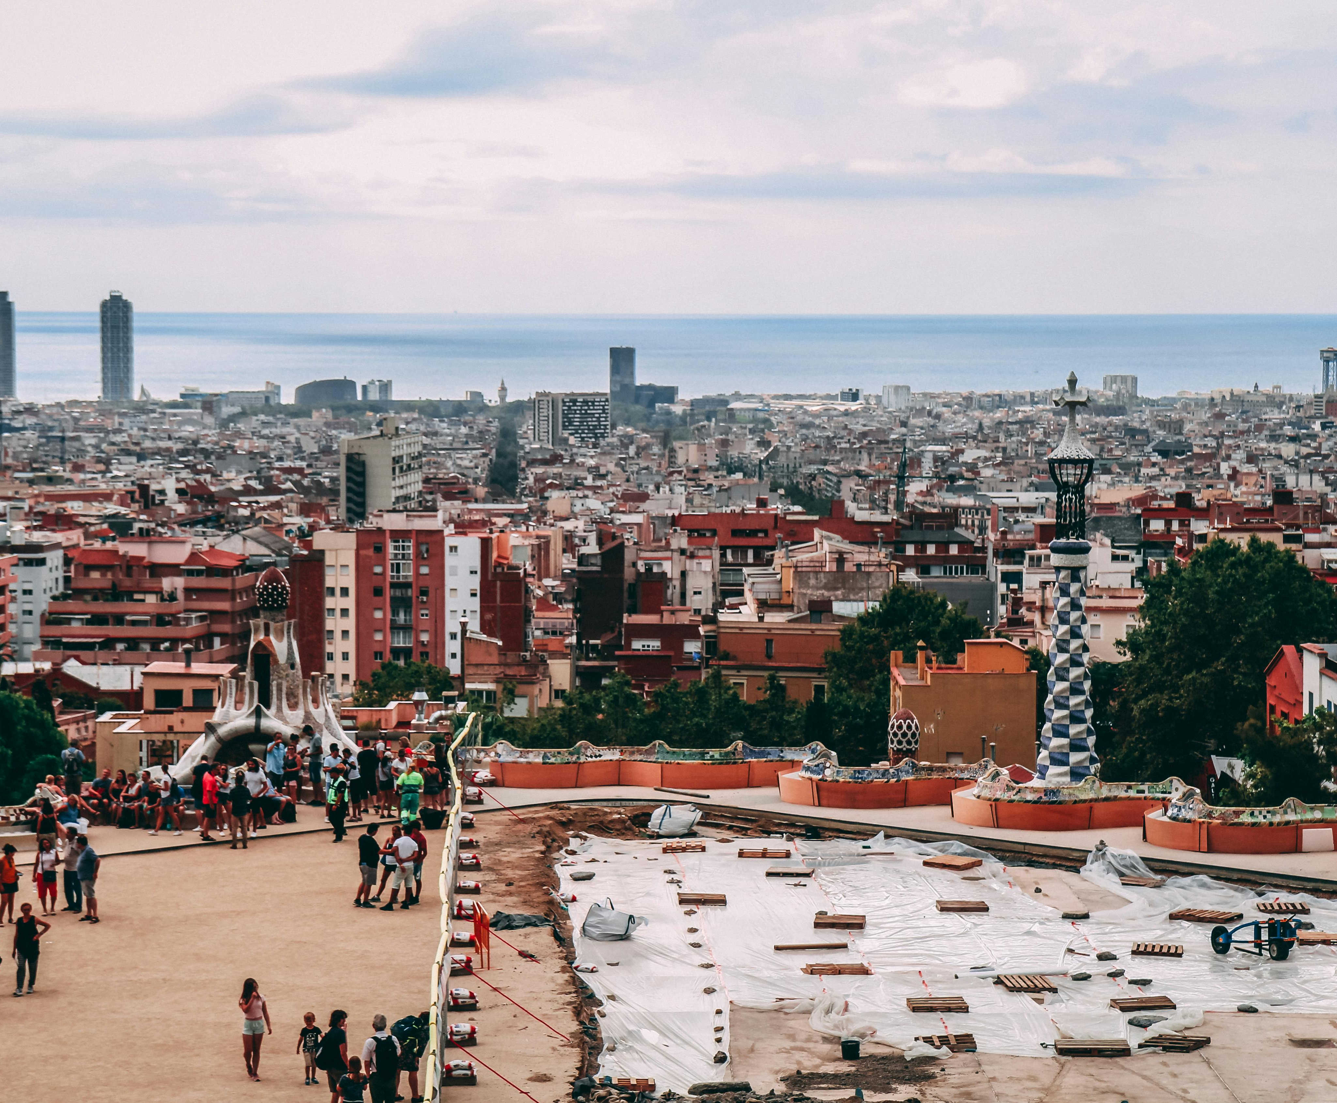
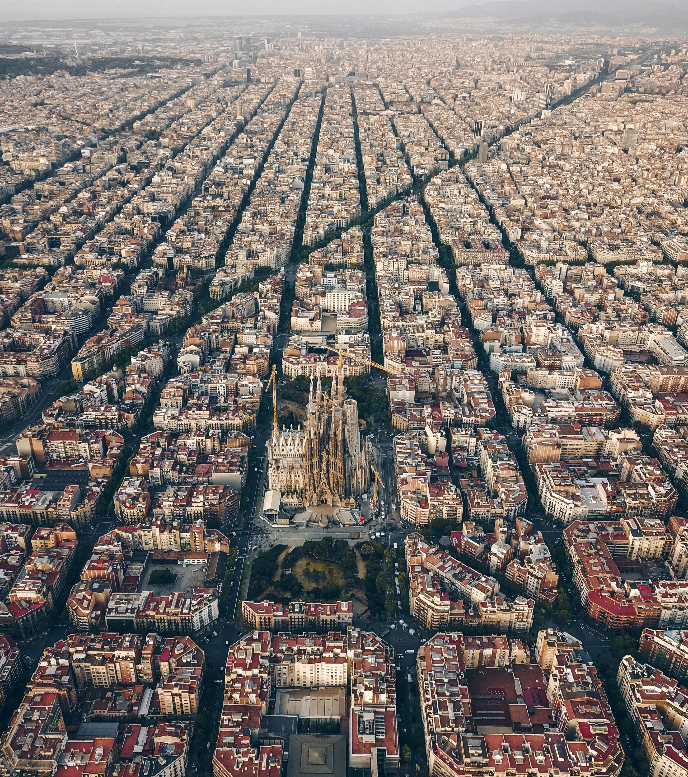
Introduction
What and where is Barcelona?
Barcelona is a city on the northeastern coast of Spain. It is the capital and largest city of the autonomous community of Catalonia.
Barcelona has a rich cultural heritage and is today an important cultural center and a major tourist destination.

Slide 5
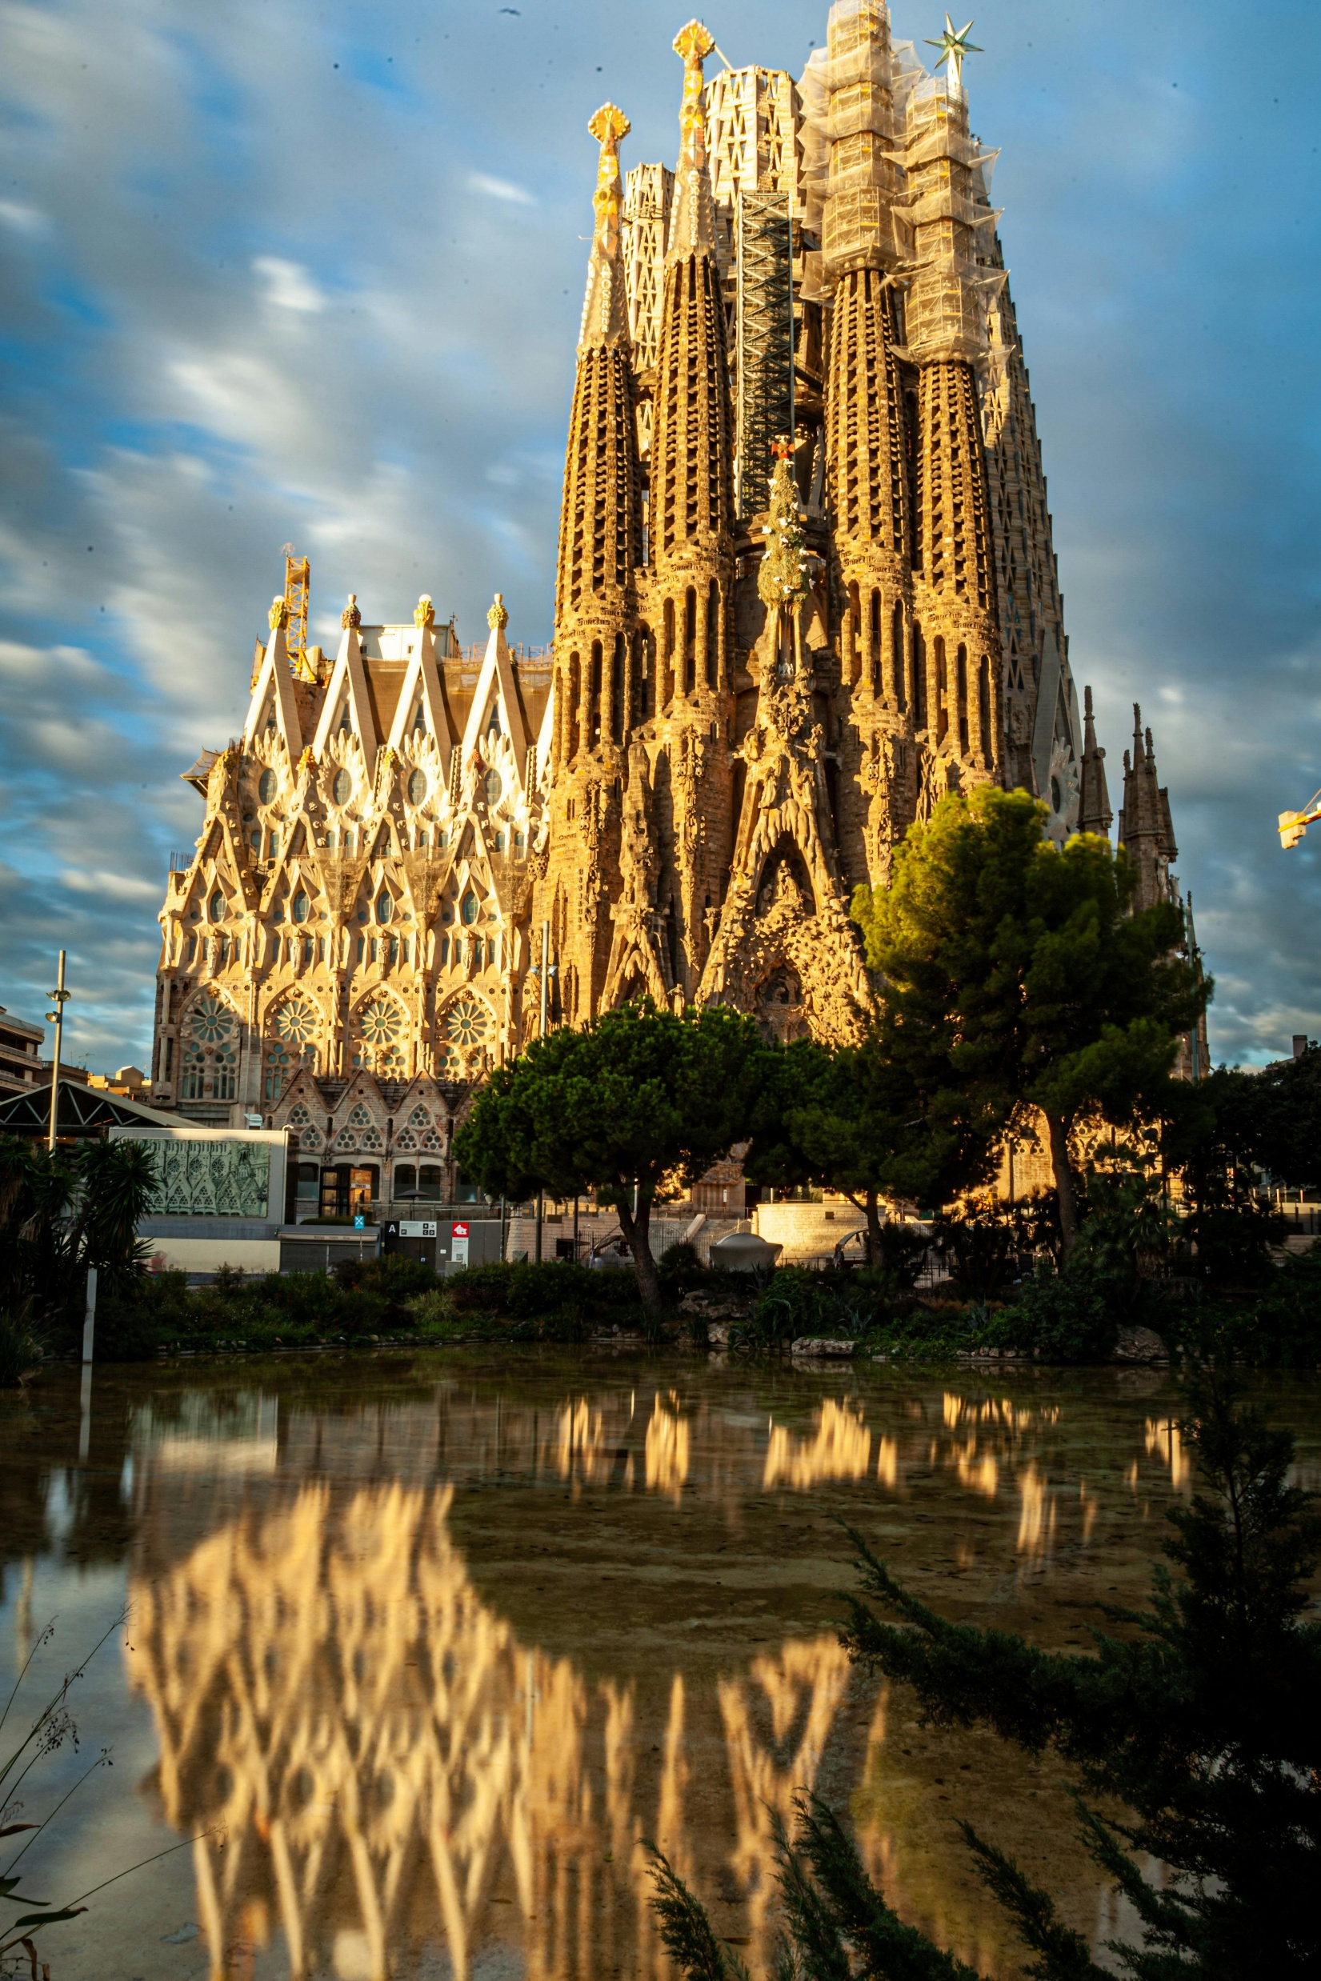
Attractions
Sagrada Família:
Sagrada Família is a church under construction in Barcelona.
It is the largest unfinished Catholic church in the world. Designed by Catalan architect Antoni Gaudí.
It is also a UNESCO World Heritage Site.

Slide 6
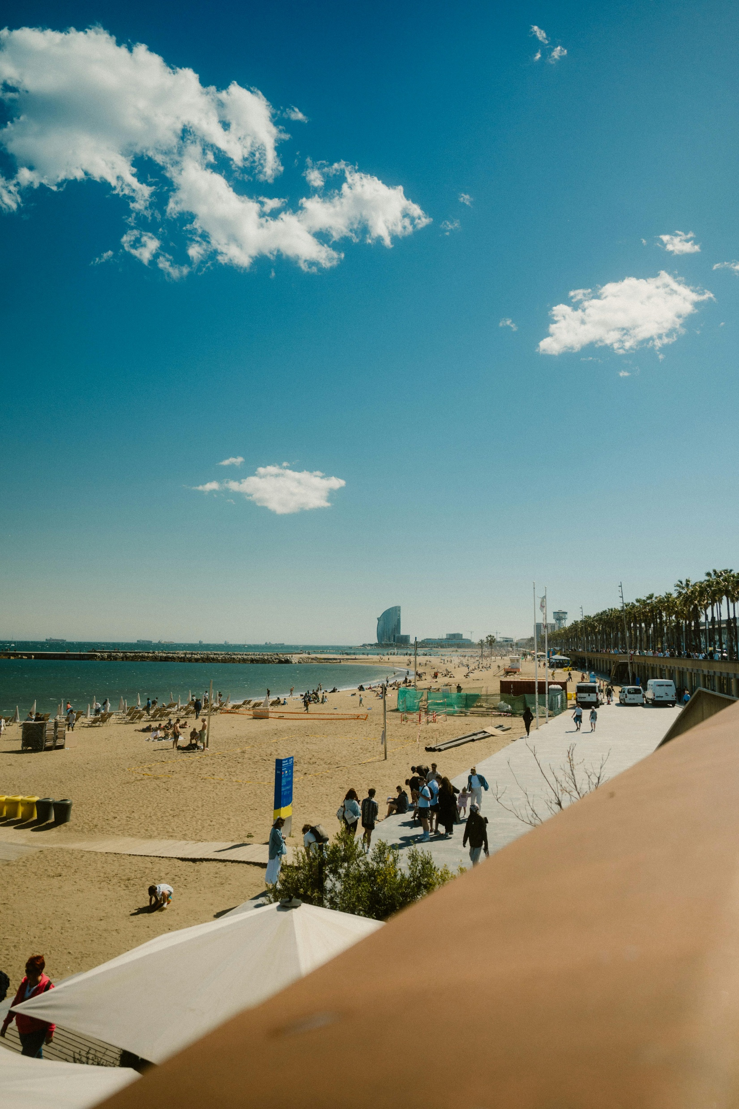
Attractions
Barceloneta Beach:
Barceloneta Beach is known for its sandy beaches and its many restaurants and nightclubs along the boardwalk.
La Barceloneta still retains the scent of salt and marine life. For many, this is considered a luxury.

Slide 7
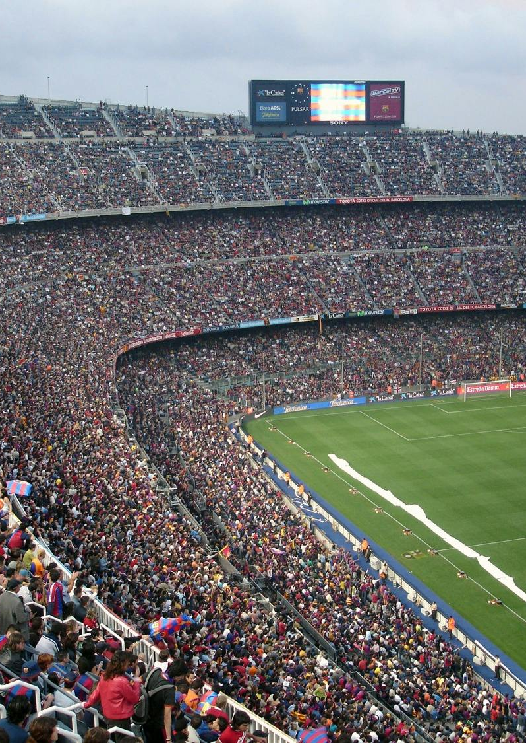
Attractions
Spotify Camp Nou:
Camp Nou is a stadium in Barcelona and the home of one of the biggest football clubs in the world, FC Barcelona.
This is a great destination for a football enthusiast.

Slide 8
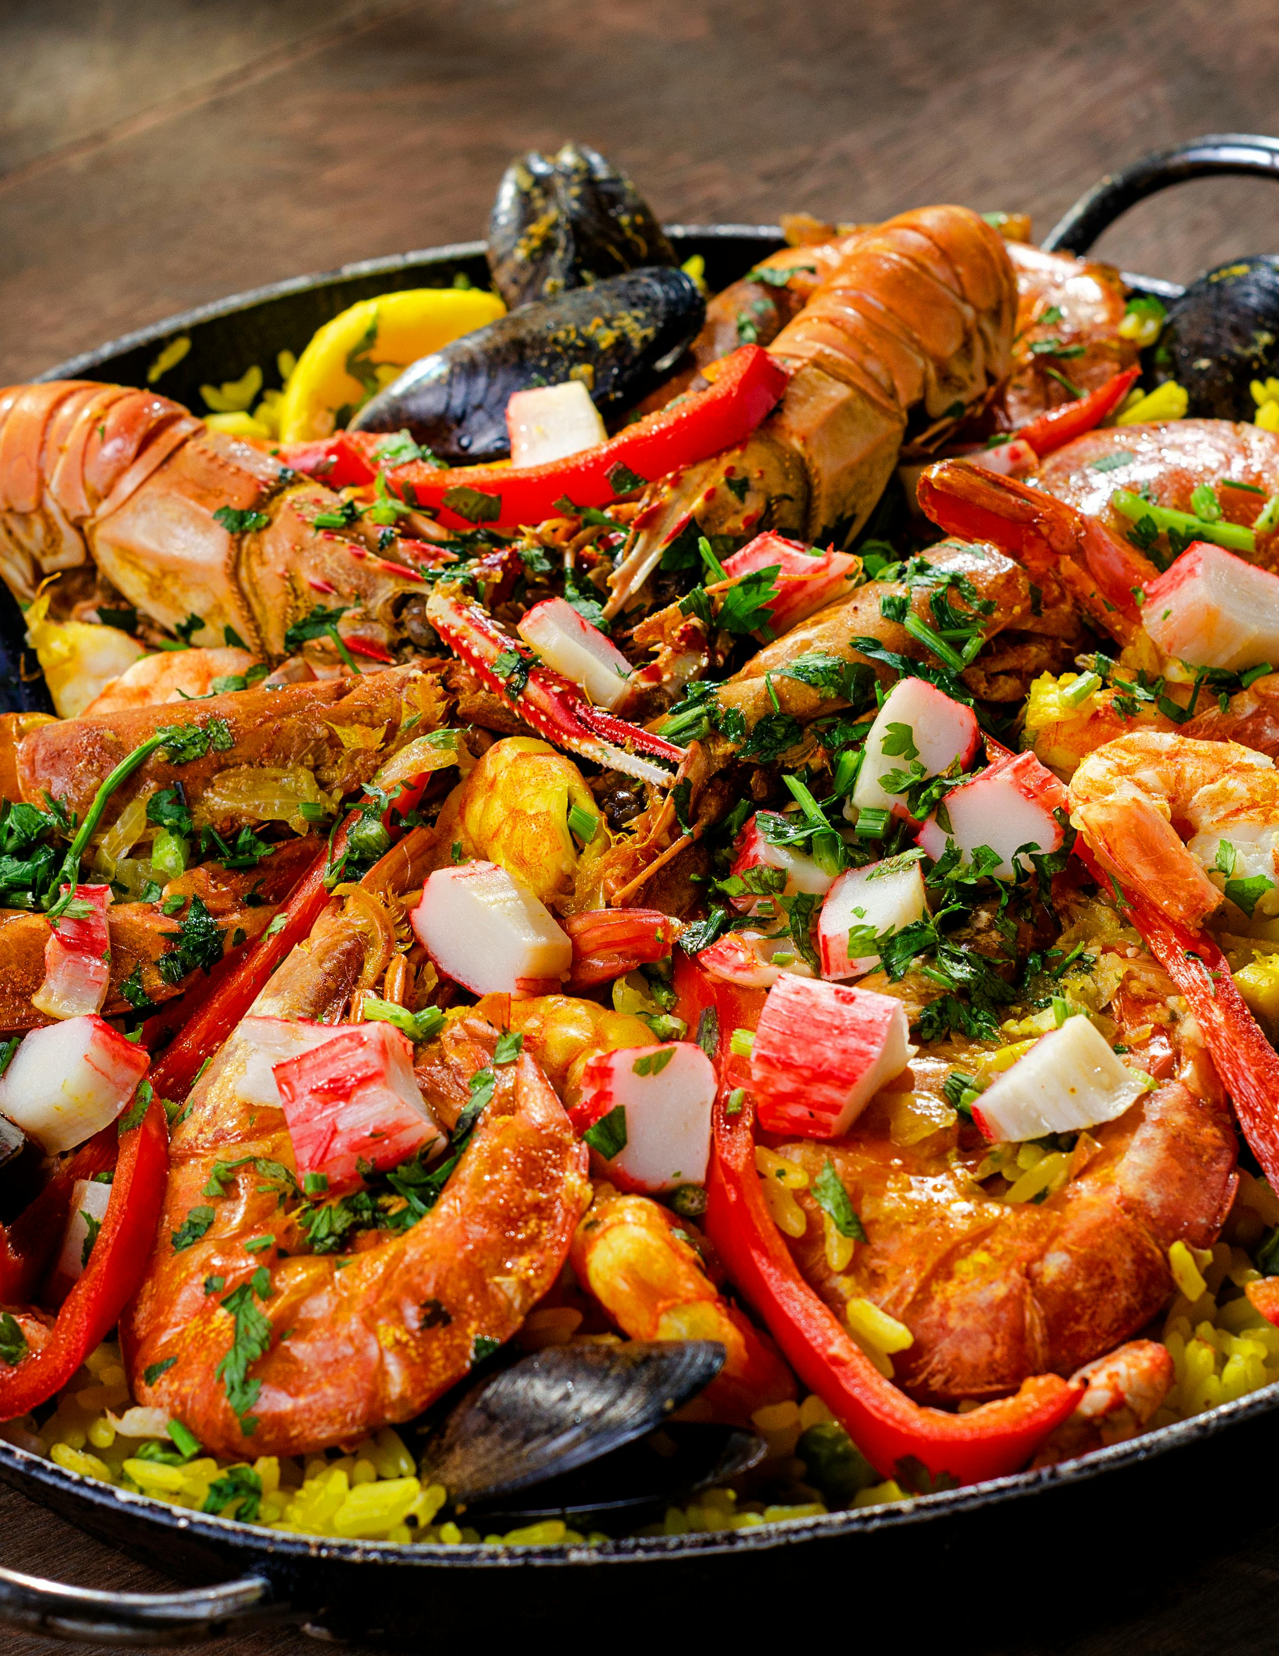
Foods
Paella Valenciana:
Traditional dish
Believed to be the original recipe
Made of Valencian rice, olive oil, rabbit, chicken, saffron, tomato, ferradura or flat green bean, lima beans (Phaseolus lunatus), salt and water.

Slide 9
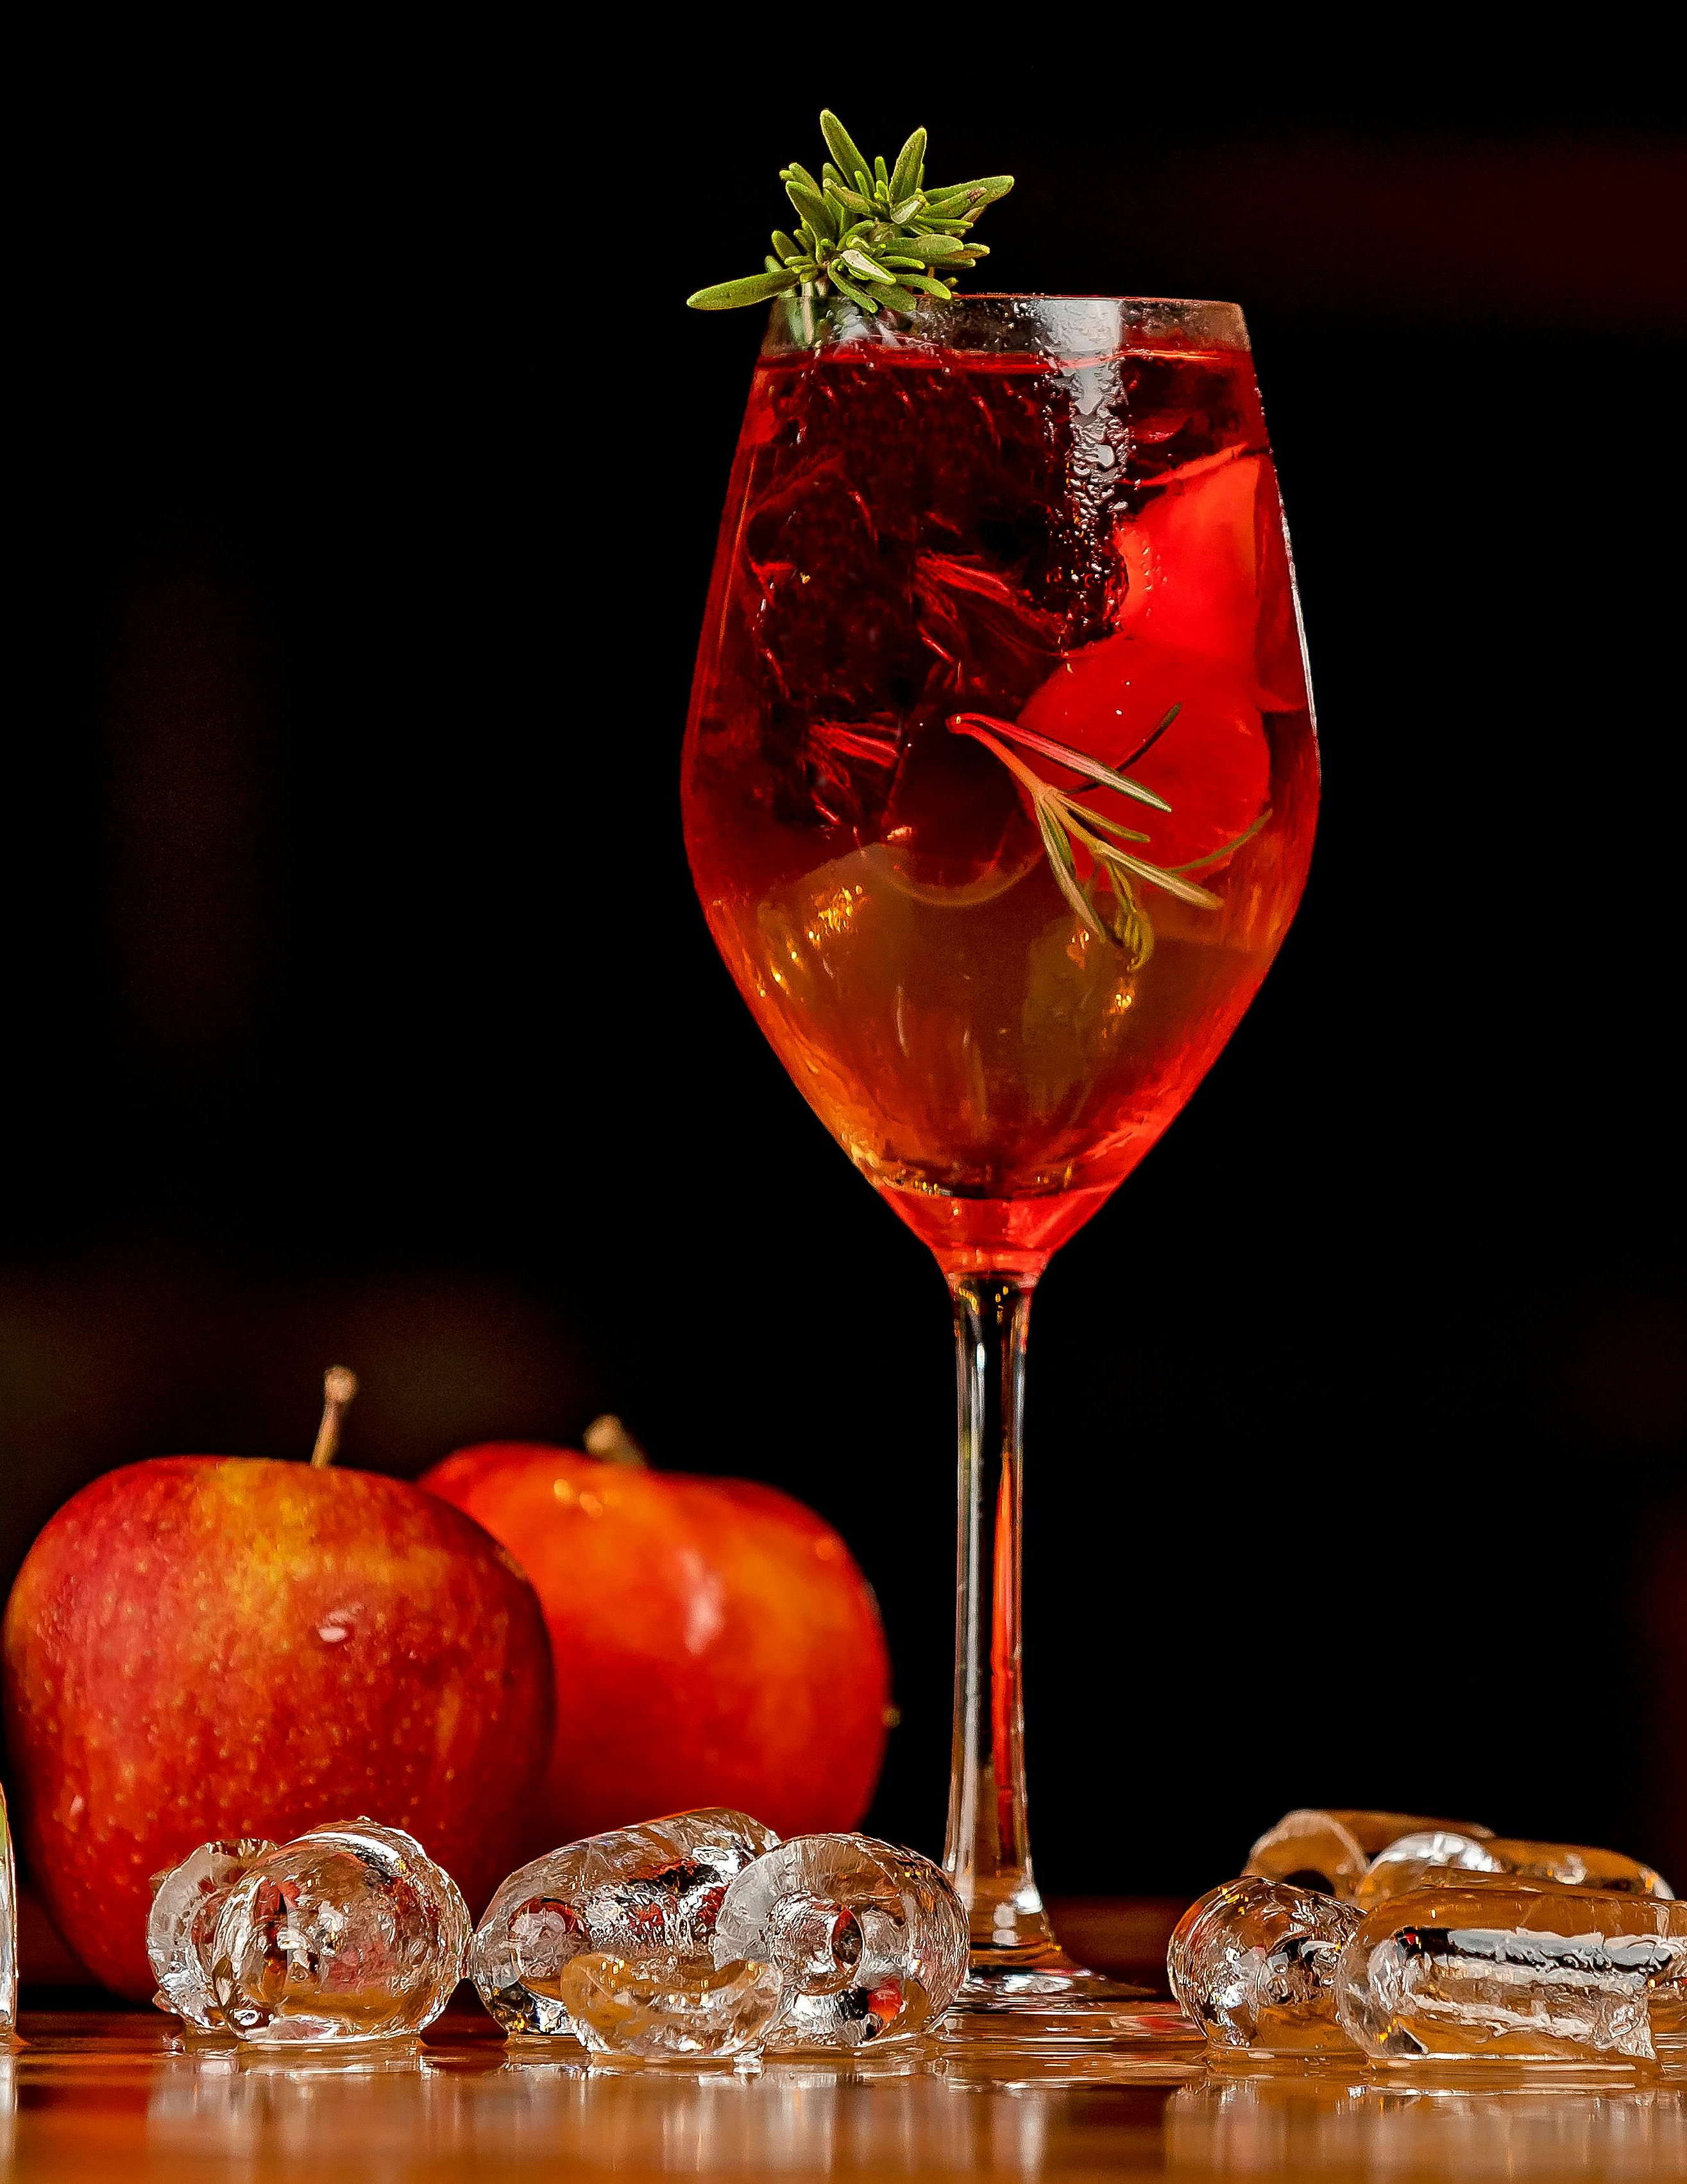
Foods
Sangria:
Made of red wine and chopped fruits
Incredibly popular with tourists.
While Barcelona locals do drink Sangria, this beverage is really a tourist favorite!
Numerous different fruits can be used, including peaches, berries, apples, lime, pineapple, and more.

Slide 10
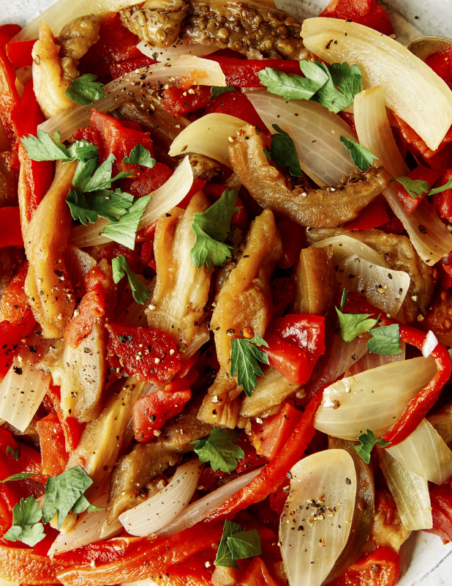
Foods
Escalivada (Vegetarian):
It is a mix of bell peppers, onions, and eggplant
Made with coated in olive oil and scattered with thyme and basil.
It’s eaten with fresh bread and can be served warm or cold.
Escalivada is a great choice for vegans and vegetarians when visiting Barcelona.

Slide 11
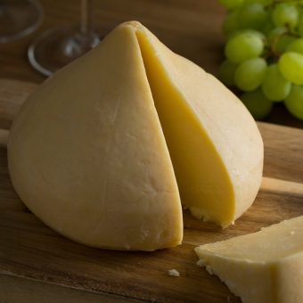
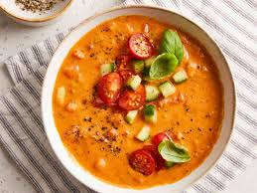
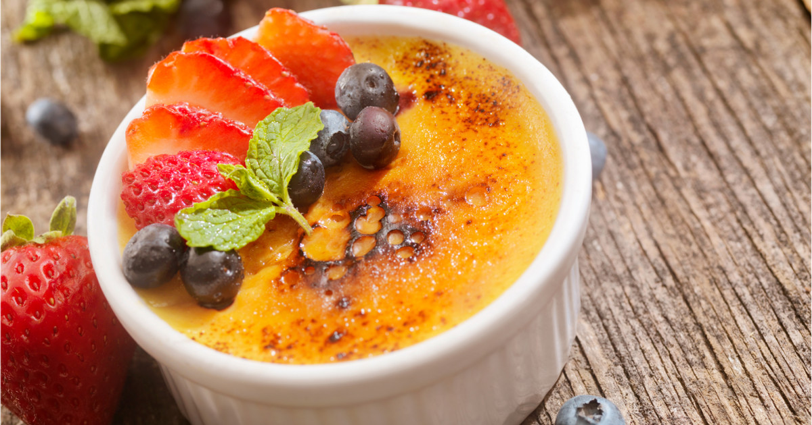
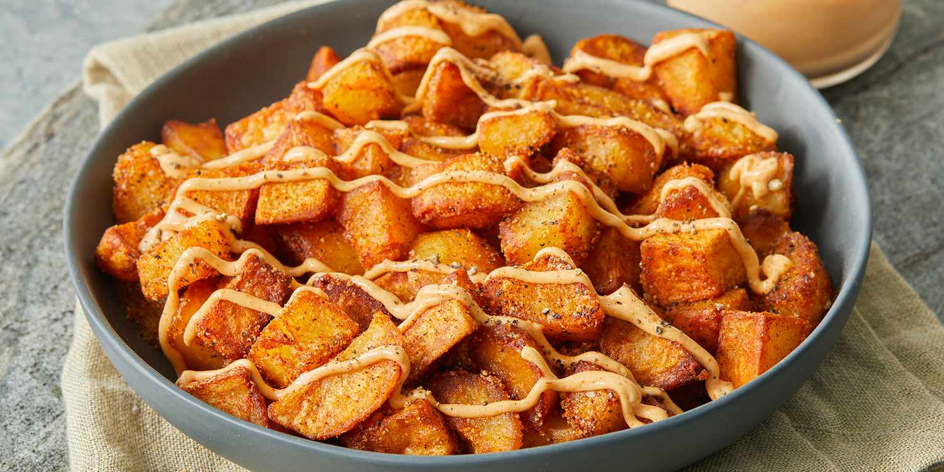
Foods
Other honourable mentions:
Spanish Cheese - Spanish cheeses are among the best in the world
Gazpacho - Ice-cold soup that is one of the best things to eat in Barcelona
Crema Catalana – Sweet flavor
Patatas bravas – Spicy flavor

Slide 12
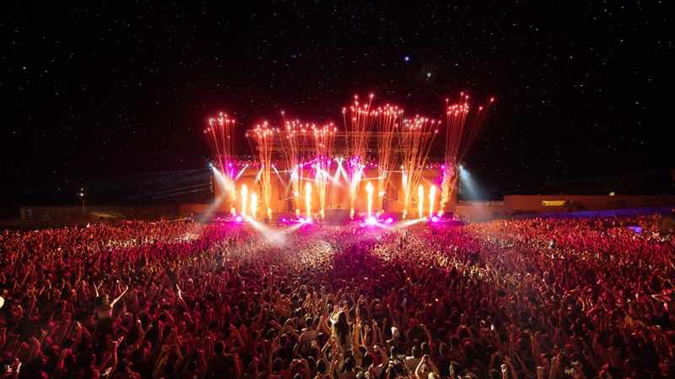
Festivals and Events
Barcelona Beach Festival:
An electronic music festival which is held annually.
It is organized by Live Nation, and it is estimated that more than 70,000 people attend annually.
It is one of the biggest music festivals in Spain.

Slide 13
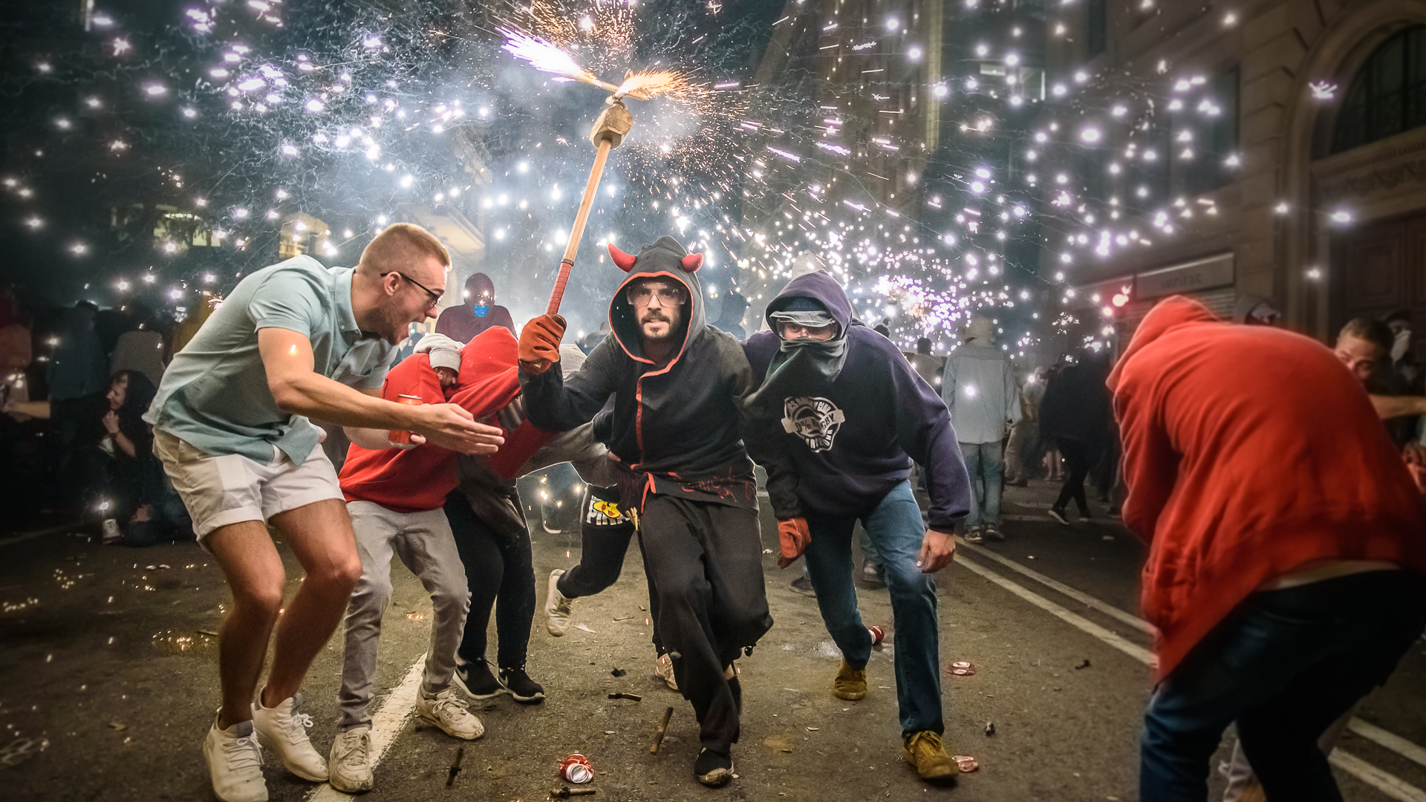
Festivals and Events
La Mercè Festival:
Every year close to the end of September Barcelona holds its largest street party, the Barcelona La Mercè Festival.
Barcelona La Mercè lasts for around 5 days and is a festival held in honour of the Patron Saint of Barcelona.

Slide 14
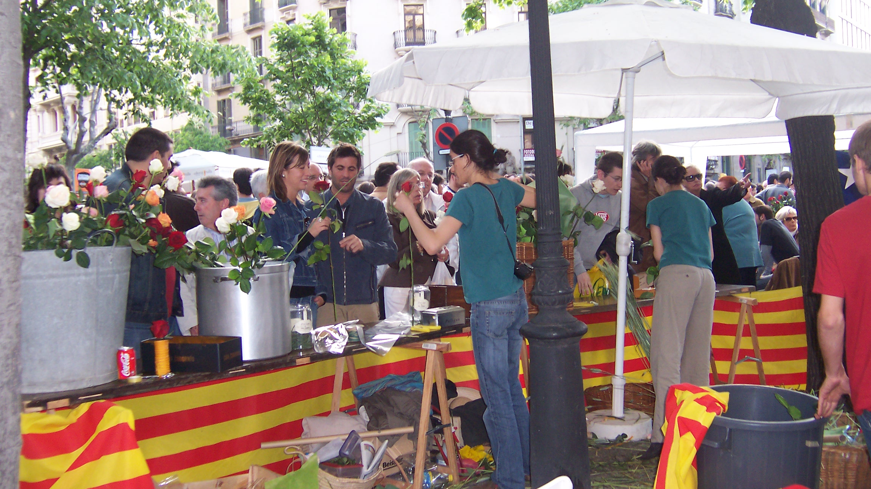
Festivals and Events
Sant Jordi's Day:
Sant Jordi's Day is celebrated annually on April 23.
In Catalonia, the main activity is the exchange of roses and books between sweethearts, loved ones and colleagues.
From the 1920's, men gave women roses, and women gave men a book to celebrate the occasion

Slide 15
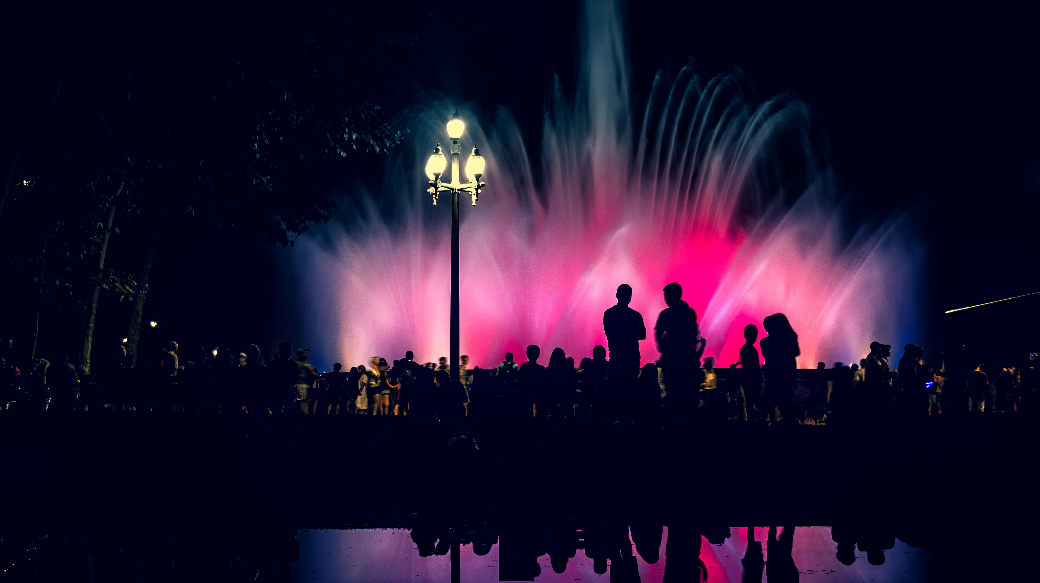
Activities
Magic Fountain:
The largest fountain of Barcelona
See the spectacular dancing fountain show with music, water acrobatics, and light.
Special thing: tourist can visit the show for free. There is no charges for anyone.
Recommendations: to visit it during the night

Slide 16
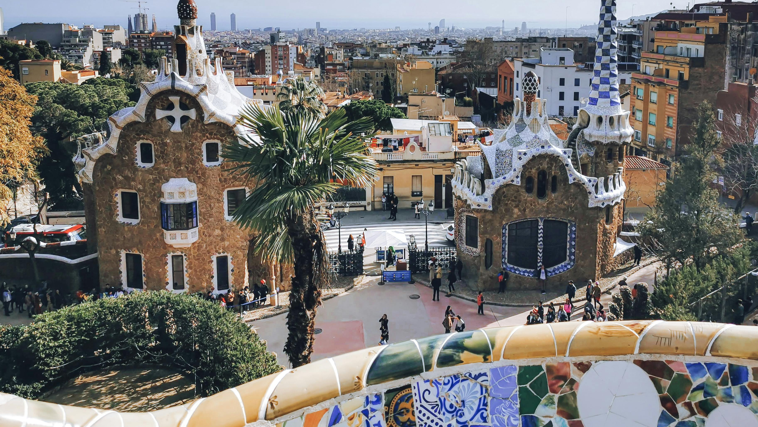
Activities
Gaudi Park:
Before 2023, you do not have to pay for the tickets, but it is not free anymore.
You can visit the Sala Hipòstila, where the ceiling has small domes decorated with mosaics.
Austrian Gardens area where you can see different types of tree.
Fun Fact: most them are donated by the general public

Slide 17
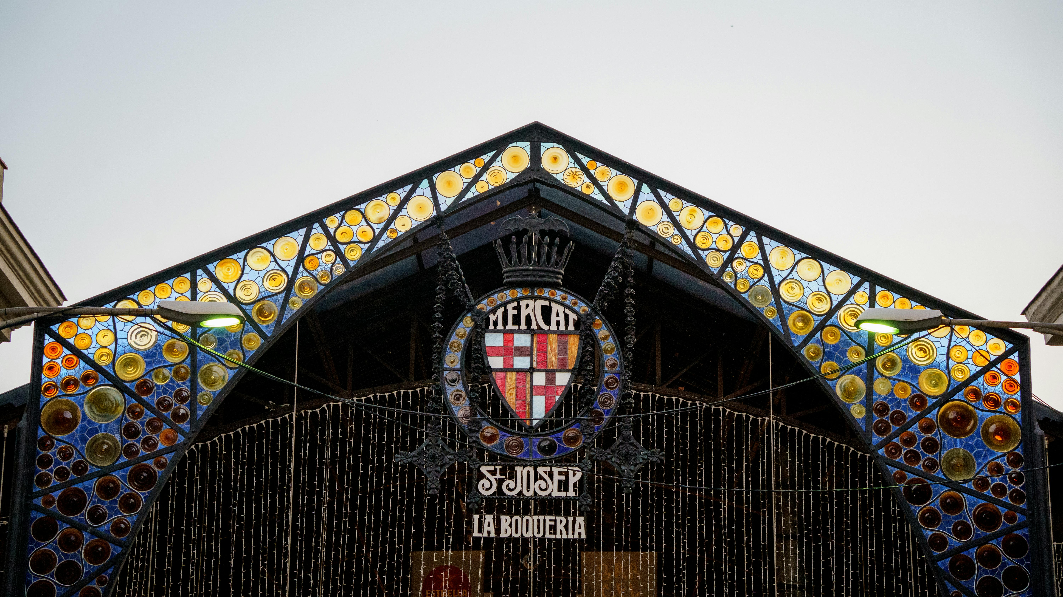
Activities
La Boqueria Market:
Name meaning: place where billy goat meat was sold.
You can buy meat dishes and fruits.
Tip: Don’t buy everything at the first stall you see. Prices at the entrance are higher than those in the central shops.
It always closes on Sundays.

Slide 18
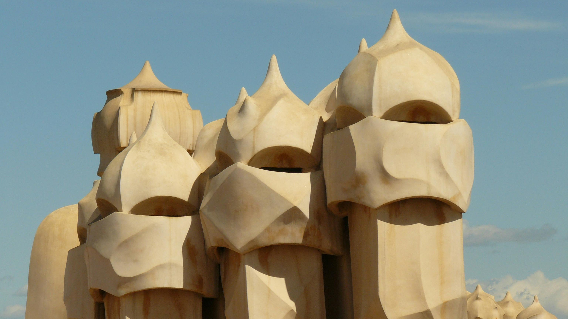
Summary
Why Choose Barcelona?
Unique blend of history, culture, and fun.
Offers something for everyone, from foodies to art lovers.
So, book your flight and visit Barcelona next summer!

Slide 19
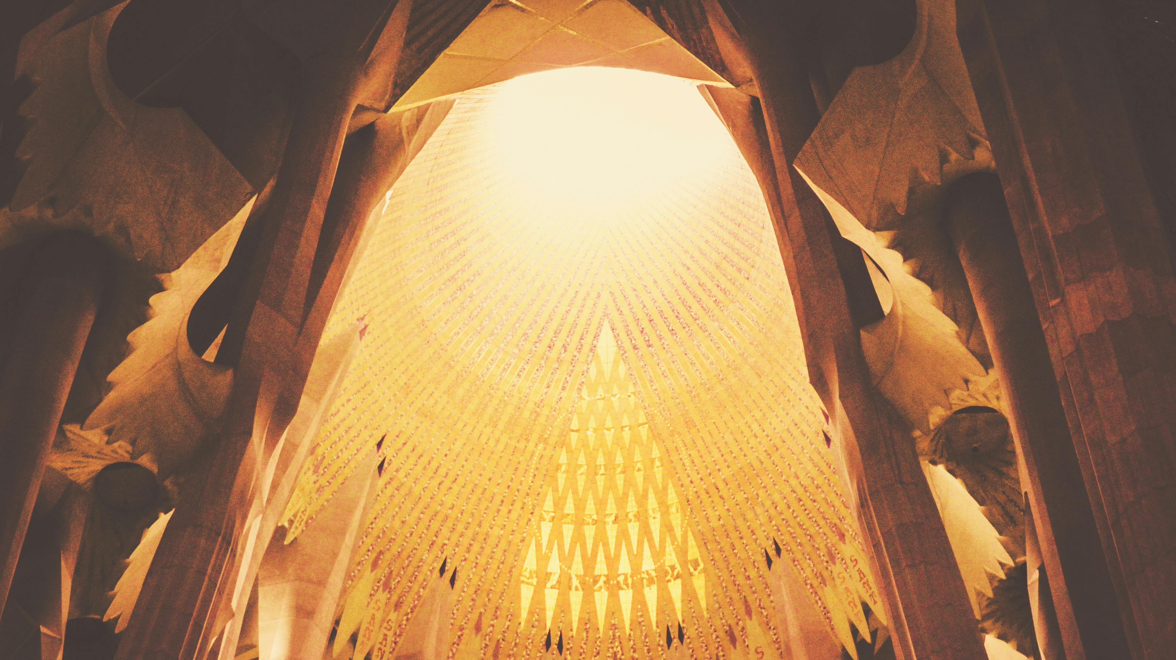
References
https://en.wikipedia.org/wiki/Barcelona_Beach_Festival
https://en.wikipedia.org/wiki/La_Merc%C3%A8
https://en.wikipedia.org/wiki/Saint_George%27s_Day_(Spain)
https://ticketshop.barcelona/magic-fountain.html
https://ticketshop.barcelona/park-guell.html
https://ticketshop.barcelona/boqueria-market.html
https://en.wikipedia.org/wiki/Barcelona
https://en.wikipedia.org/wiki/Sagrada_Familia
https://en.wikipedia.org/wiki/La_Barceloneta,_Barcelona
https://en.wikipedia.org/wiki/Camp_Nou
https://www.getyourguide.com/explorer/barcelona-ttd45/food-in-barcelona/
https://www.barcrawlbarcelona.com/must-try-drinks-while-in-barcelona/
https://www.celebritycruises.com/blog/barcelona-food#:~:text=Escalivada,-Escalivada&text=A%20simple%20Catalan%20dish%20of,scattered%20with%20thyme%20and%20basil

Slide 20
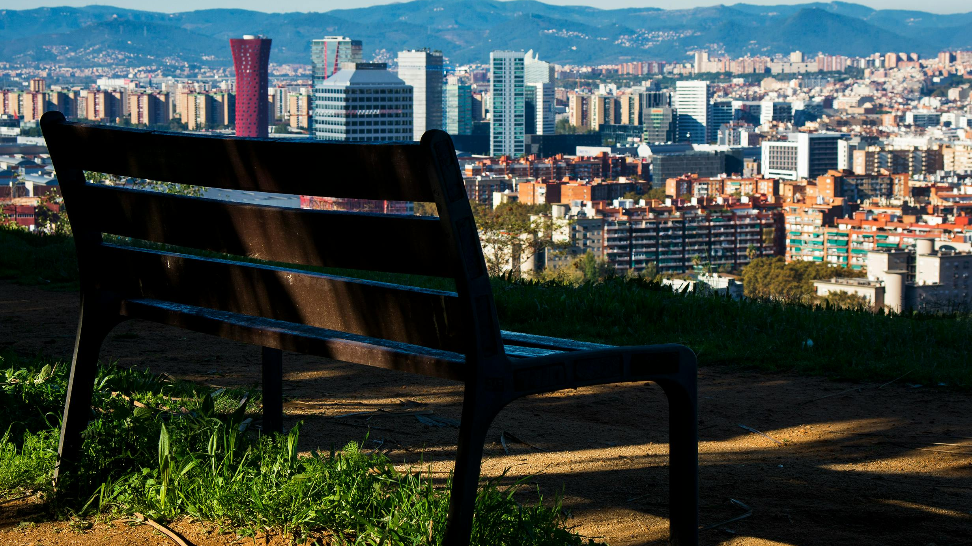
THANK YOU!

